Slide 1
Churn Modeling

Slide 2
Can you Predict when a customer leaves?
The Problem

Slide 3
Data
A synthetic data set of bank customer information was used from the website kaggle
It contains customer demographics and account information
The data set has 10000 entries

Slide 4
Data exploration
The data was first examined using descriptive statistics.
The data was examined for any null values
Visualizations were created to look for trends in each of the features

Slide 5
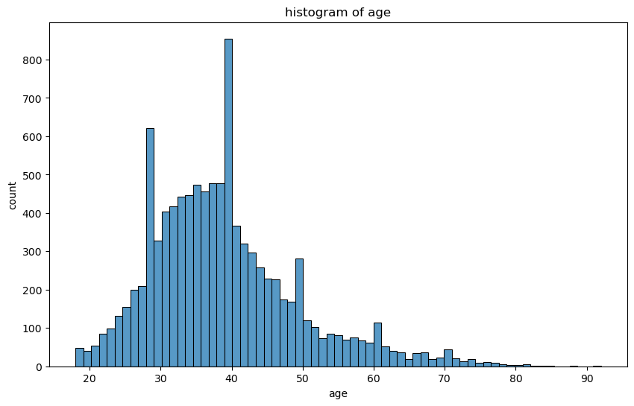
Upon first review it looks like most customers are between 30 and 40

Slide 6
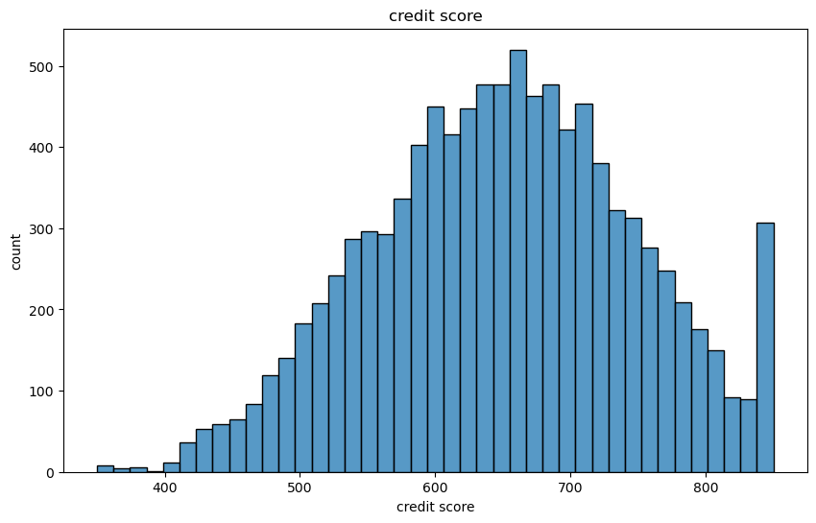
Initial histogram of credit score is hard to grasp

Slide 7
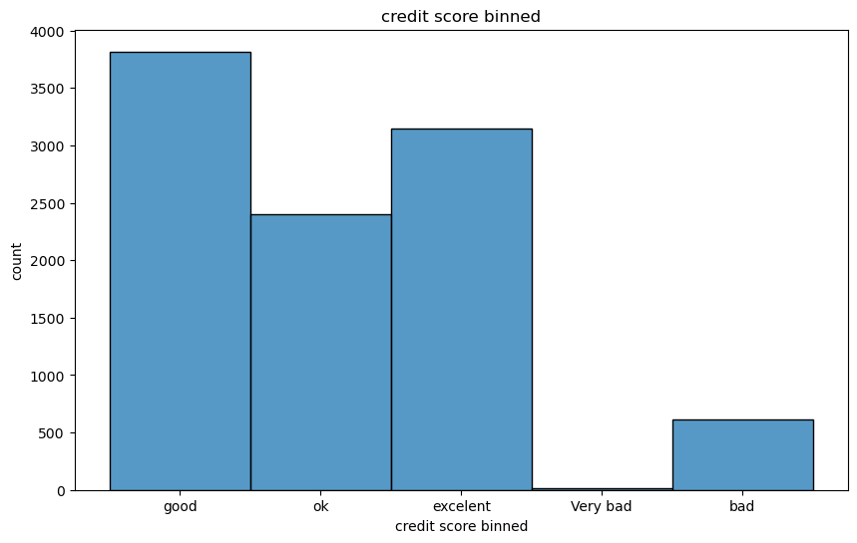
Transforming the data we can see most people have good credit

Slide 8
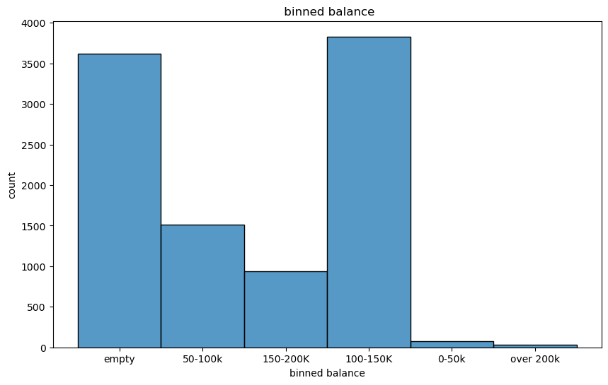
Interestingly most customer either have almost no money in the bank to 100k-150k

Slide 9
20.37%
The percent of the current customers that leave
Based on this data set means a bank lost 2037 customers

Slide 10
What kind of customer leaves?

Slide 11
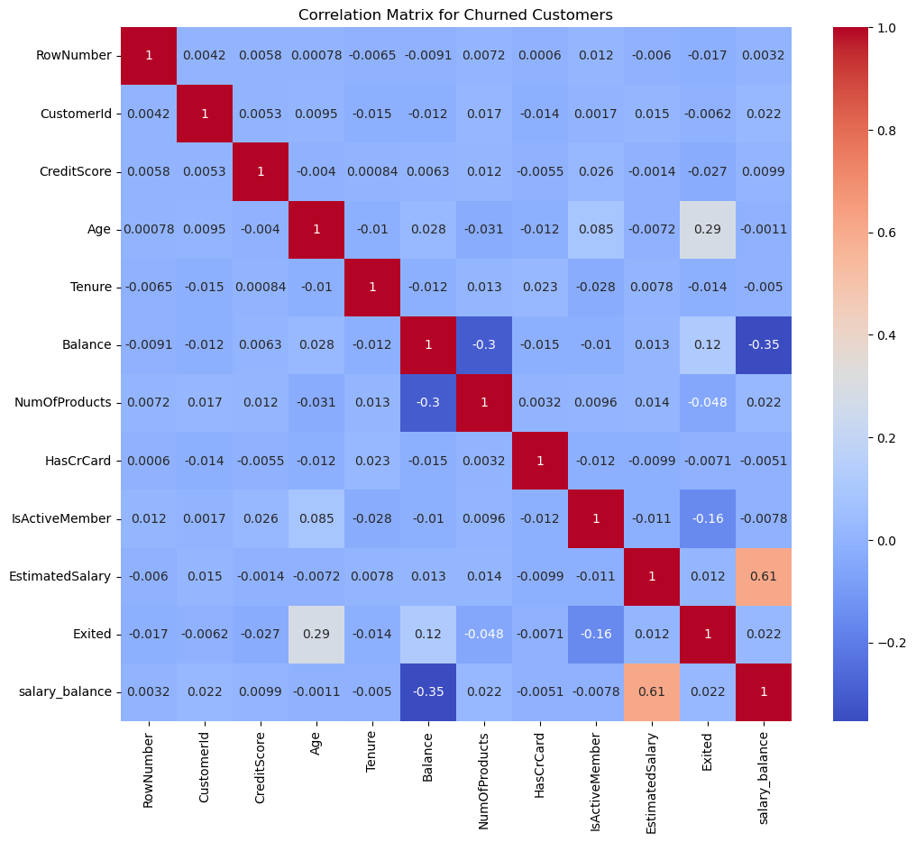
A correlation matrix was run to see which features may yield good insights

Slide 12
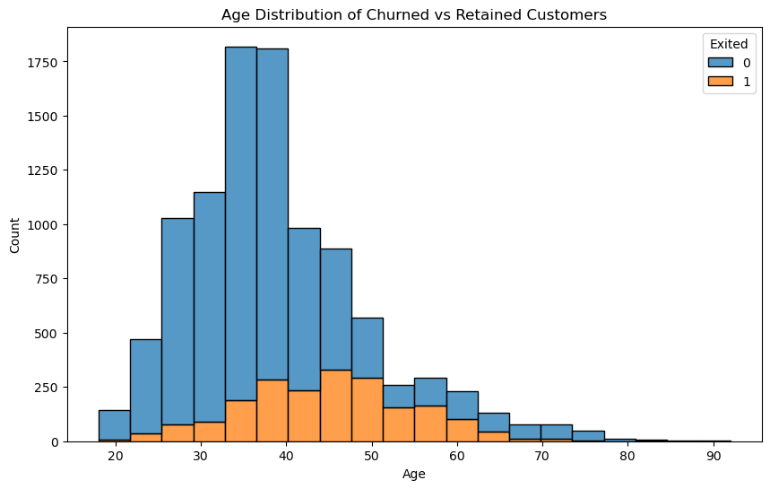
Customers in their late 30s to 50s seem to be leaving

Slide 13
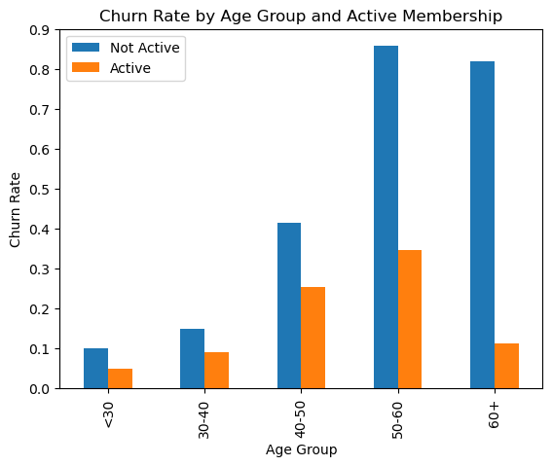
Customer who are older than 50 and inactive is more likely to leave

Slide 14
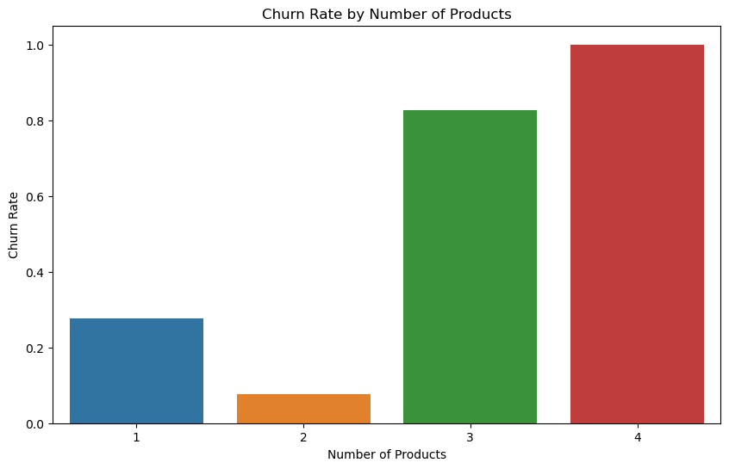
Interestingly the customers that leave have multiple products with the bank

Slide 15
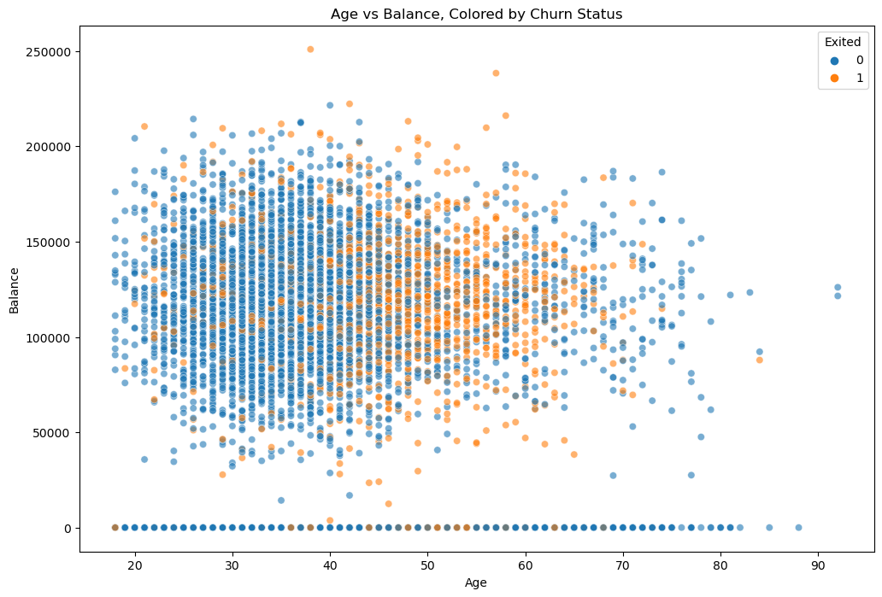
We can see here customers who have about 100K-150K and in their 40s to late 60s are more likely to leave

Slide 16
The bank is losing a valuable demographic.
Notes:
These customers use many products and have alot of money saved in the bank

Slide 17
How can the bank retain more customers?

Slide 18
We can build a model to predict who will leave
By splitting the data between the churned feature vs the remaining data set we can begin to train a model to predict churn
A Tensor Flow model, Random Forest Classifier and Decision Tree Classifier was created to see what works best

Slide 19
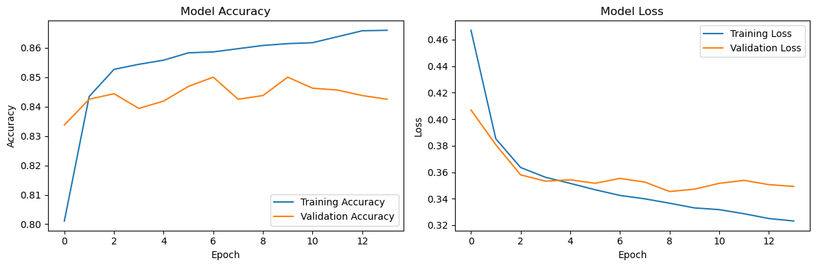
We can see that the TensorFlow model achieved 86% accuracy
Our other models Random Forest Classifier and Decision Tree Classifier received similar accuracy levels

Slide 20
Summary
The previous insights on the churned customers can create actionable items for the bank
The bank could try to reach out to these churned customers to find why they left
The bank can make changes based on the feedback
Using the models created the bank can reach out to customers at risk of leaving and find ways to retain them
Notes:
Tensor flow model

Slide 21
Future Action
The TensorFlow model is a powerful model and it would be interesting to see if this model will work on other customer data to see how accurate it will work.
Fine tuning this TensorFlow model for real time analysis to identify customers before they become at risk for leaving.
For operational purposes it would be interesting to see if the alternate models operate faster in real world situations.

Slide 22
Questions?

